Slide 1
Android Development
Making a Simple Game on Android

Slide 2
The Activity Life Cycle
Determines which methods are run when starting a new View
onCreate() is run when the view is first created
onResume() is run after onCreate() or when the app comes back from a paused state
onPause() is run when a second app is run minimizing your app
onStop() is run when your app is no longer visible
onDestroy() is run when the app is finishing or terminated by the system
onRestart() is run when coming out of a stop state and will call onStart() when it finishes

Slide 3
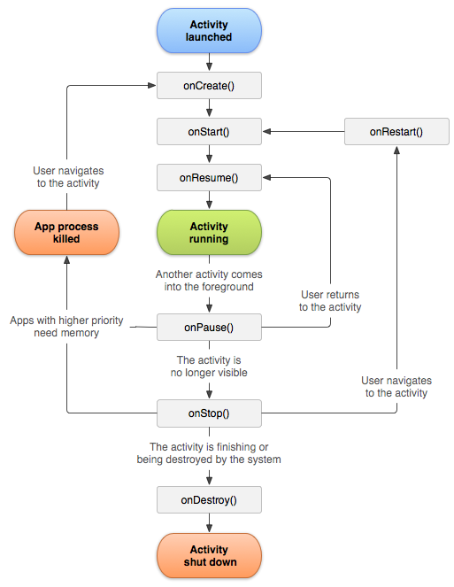
The Activity Life Cycle

Slide 4
Listeners/Callbacks
Listeners are what make user interactions run code
Buttons will have a listener that will listen until the user taps them, and will then perform its function
Make dynamic programs

Slide 5
R
Like many UIs Android’s layout is stored in an xml file
Because of the separation of layout and Java code the two must be connected at compile time
“R” is a class generated that contains all of your resource files. This includes all your views, buttons, labels, images, and so on.
R allows you to reference these resources in Java code by looking up their ids

